Slide 1
preprocessing

Slide 2
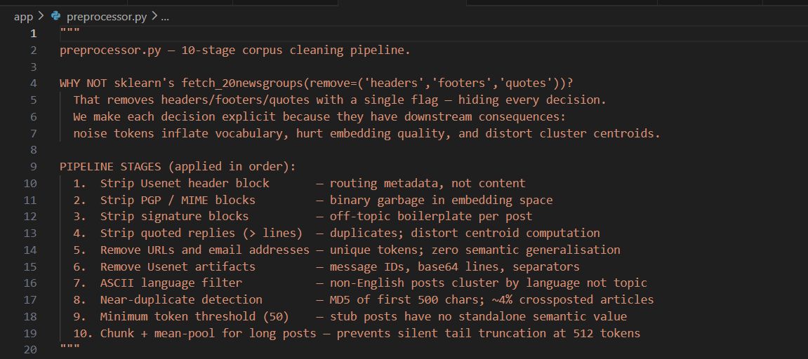
preprocessing

Slide 3
Vector embeddings
Model Dim Size SBERT MTEB Notes
────────────────────────────────────────────────────────
all-MiniLM-L6-v2 384 90MB 68.1 ✓ CHOSEN
cosine_similarity
MODEL CHOICE
CHUNKING STRATEGY – 512 TOKENS transformers max
The 64-token overlap prevents boundary effects where a sentence
is split mid-thought across chunks.

Slide 4
EACH vector = 384 floats × 4 bytes/float = 1,536 bytes/doc
MINILM (384D):
15,000 docs × 1,536 bytes = 23MB
MPNET (768D):
15,000 docs × 3,072 bytes = 46MB (2x)

Slide 5
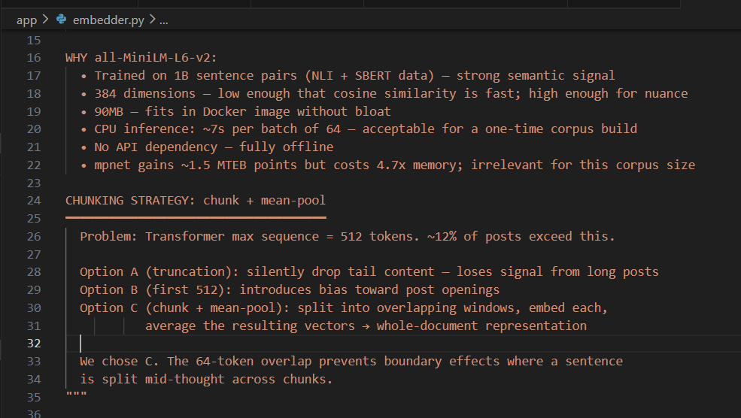
Vector embeddings

Slide 6
CLUSTERING
K-Means assigns exactly one cluster label per document
BEZDEK FCM ALGORITHM – FUZZY
Partition Coefficient (PC) – #CLUSTERING

Slide 7
CLUSTERING
UMAP dimensionality reduction + Fuzzy C-Means clustering.
pairwise distances converge to the same value as D→∞
UMAP vs PCA vs t-SNE:
PCA: Linear. Cannot capture curved manifolds in embedding space. Poor cluster sep.
t-SNE: Non-parametric. No transform() for new query vectors. Unusable at inference.
UMAP: Non-linear + parametric. Has transform() → can project new queries. ✓ CHOSEN

Slide 8
usearch HNSW vector index
Build: O(N log N). Query: O(log N). Dynamic insert: O(log N)
02_build_index.py — Embed all documents and build HNSW vector index.

Slide 9
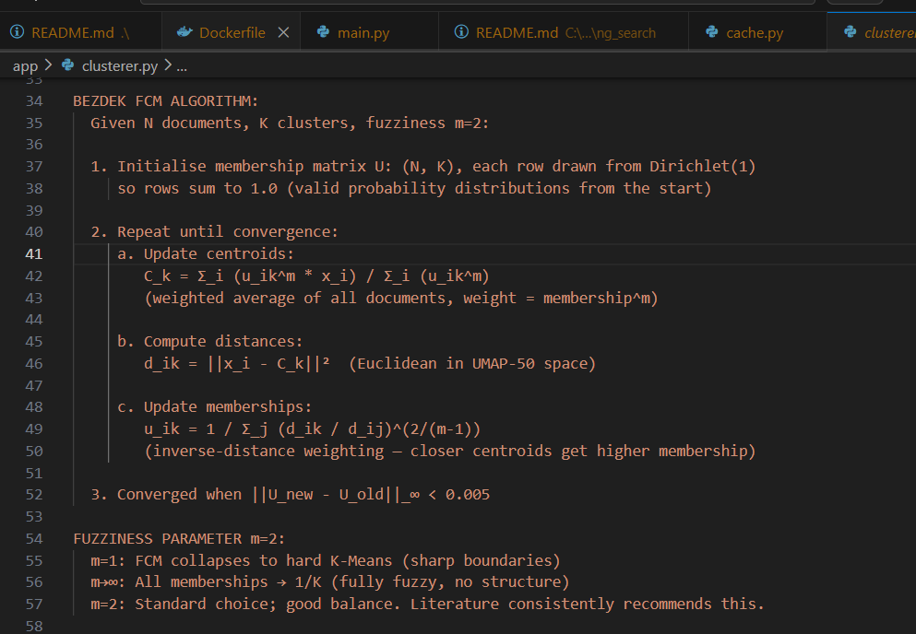
BEZDEK FCM ALGORITHM

Slide 10
CACHE
DATA STRUCTURE: {cluster_id: [CacheEntry, ...]}
PERSIST
>1HR TTL CONTINUE OR SKIP
THRESHOLD

Slide 11
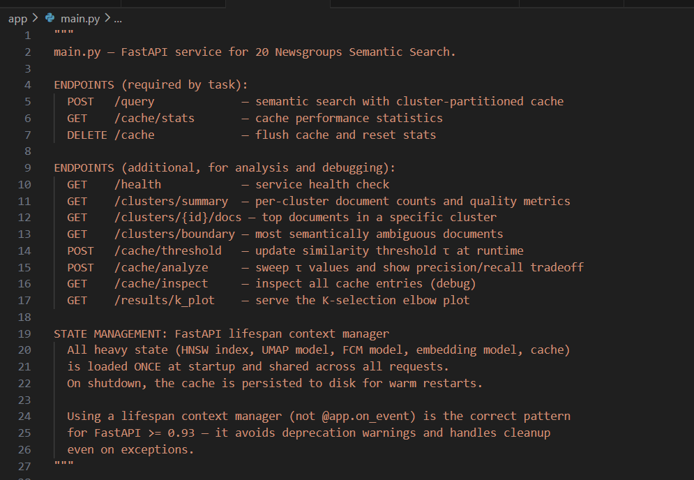
API

Slide 12
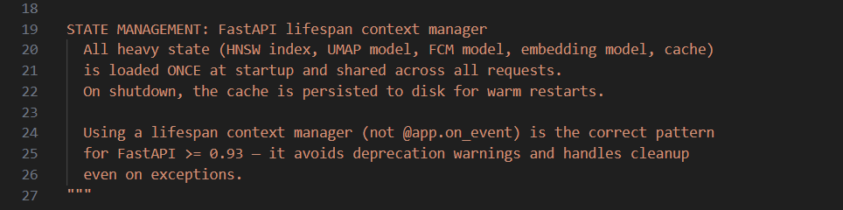

Slide 13
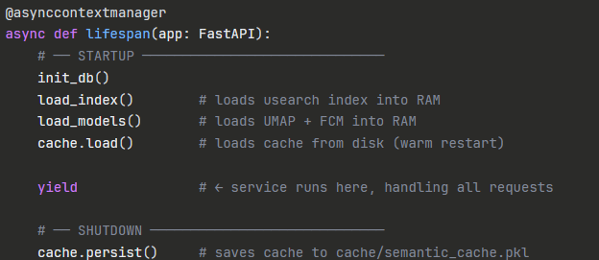
What the Lifespan Context Manager Does

Slide 14
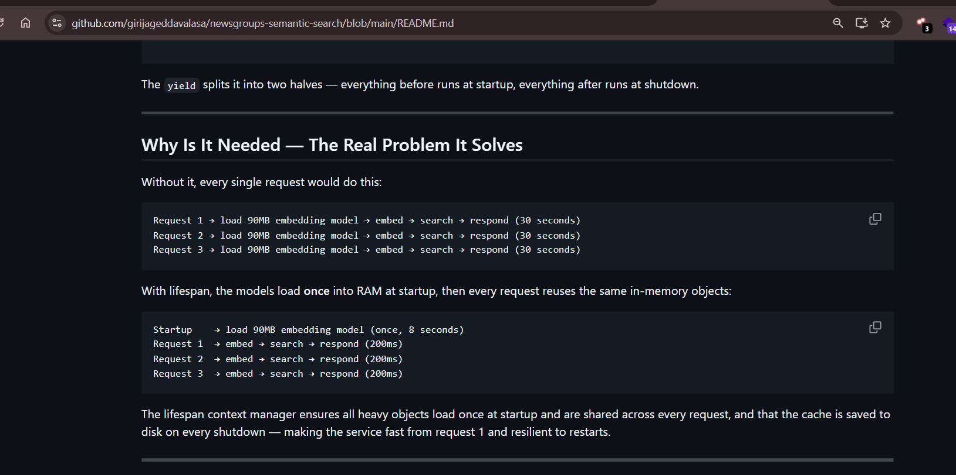

Slide 15

